Slide 1



Data analytics approach
Shirley Nakalema

Slide 2
Agenda
Introduction
Data Exploration
Model Development
Interpretation

Slide 3
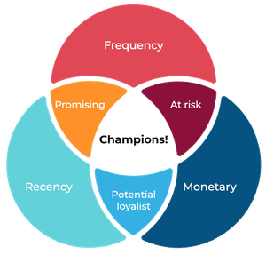
Introduction
Customer Analysis
Sprocket Central Pty Ltd is a long-standing KPMG client who specialises in high-quality bikes and accessible cycling accessories to riders.

Slide 4
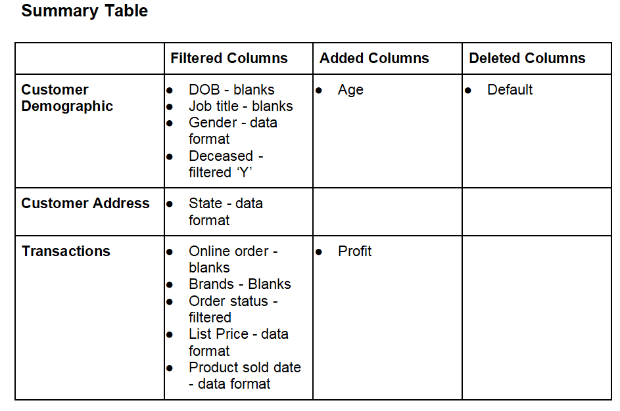
Data Exploration
Data Quality Assessment and Cleanup
During the data cleaning, some adjustments were made onto the data as follows:
Default Column was deleted
Age and Profit column were added
Blanks were removed for DOB, Job title, Gender, Online order and Order status
Formats for List price, Product sold, state and state were altered to match the rest
Deseased customers were removed

Slide 5
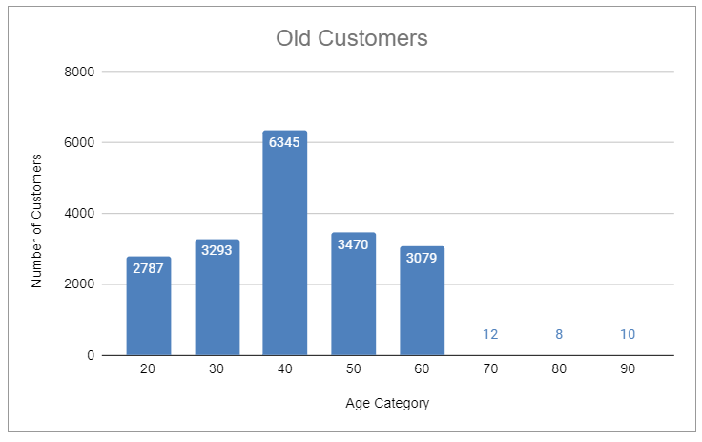
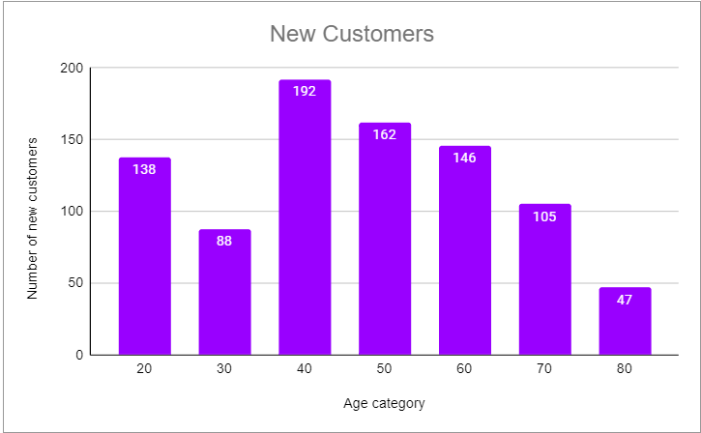
Data Exploration
Age Group
Customers are more between the age 40-49.
Customers are more between the age 40-49, followed by 30-39 and 50-69.
Less count of customers from age between 80-99.
The new customer list suggests that most customers are between the age of 20-29 and 40-69

Slide 6
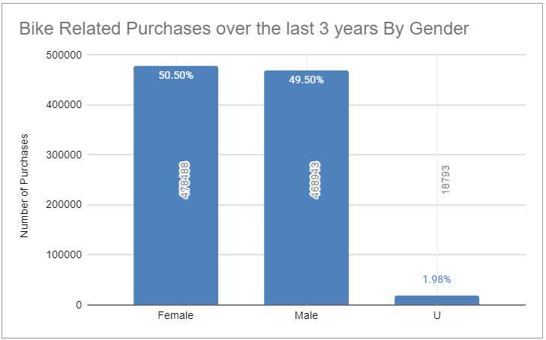
Data Exploration
Bike Related Purchases over the last 3 years By Gender
Over 50% of the bike purchases are made by females
49% made by males
2% by Unknown gender
Females purchased almost 10,000 more bikes than males

Slide 7
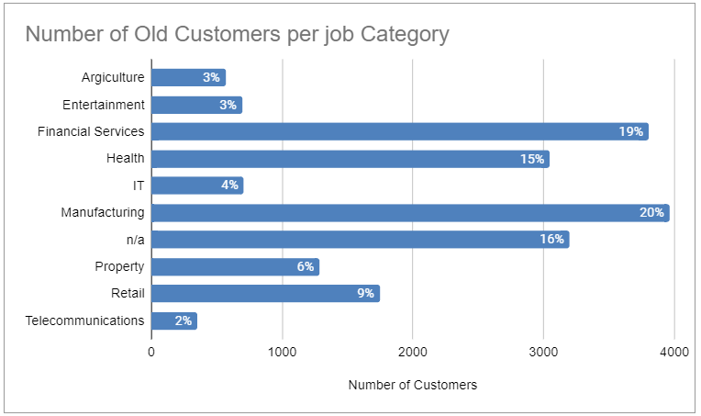
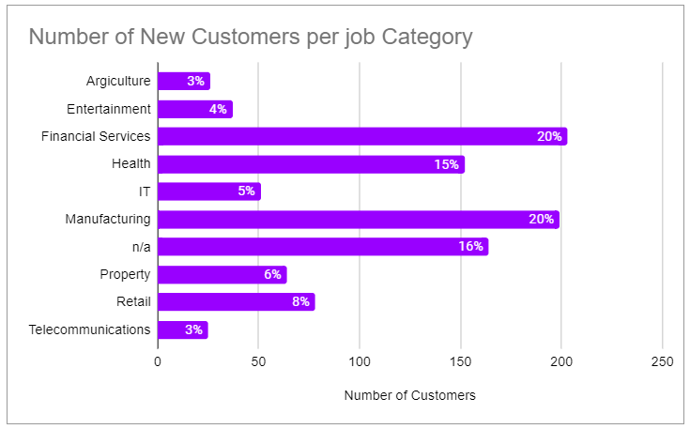
Data Exploration
Job Category
Financial Services and Manufacturing job categories are high in number for both Old and New Customers
Health industry comes in second

Slide 8
Data Exploration
Customers who own cars by state
Out of the three states, New South Wales could be the target market.
In New South Wales, the number of people who owns car is nearly equal to the number of people who don’t own vehicle. Hence, there is a good marketing opportunity for the company.
In QLD and VIC, the scenario is same as in NSW but the market is less as compared to NSW.

Slide 9
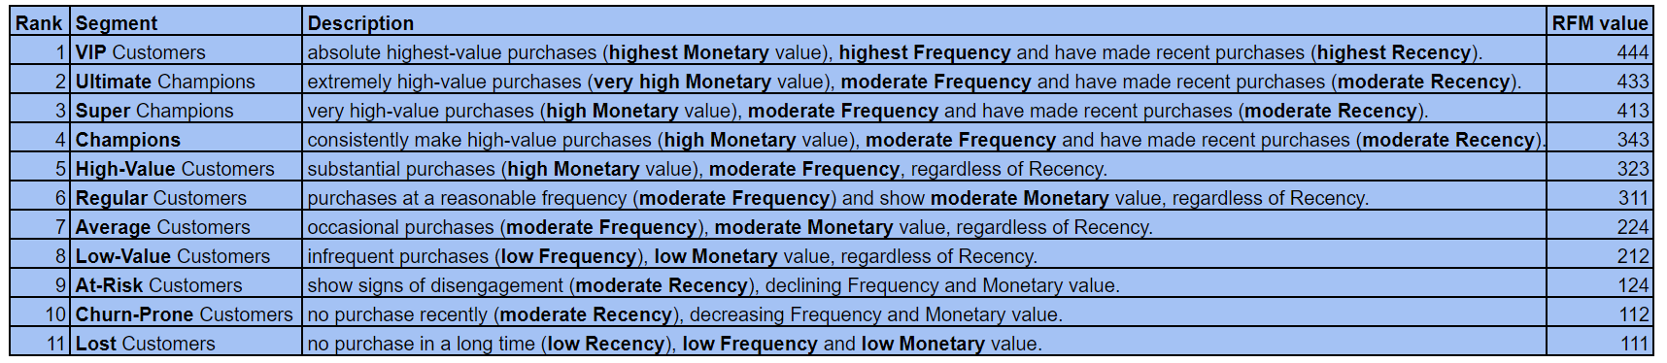
Model Development
RFM is used to determine which customers a business should target to increase ints Revenue

Slide 10
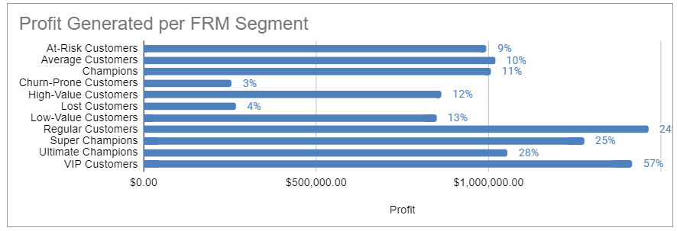
Model Development
Targeted Customer Segment Group
Regular customers are moderately engaged and make purchases with a reasonable frequency.
Regular customers are also consistent buyers and have the potential to become high-value customers with the right incentives and personalized marketing strategies.

Slide 11
Interpretation
Targeting Customers
Age : People aged between 35-55.
Gender : Female are a slight high in number than male.
Job Category : Peoples working in Financial Services, Manufacturing and Health.
Location : People who lived in New South Wales.
Age | Gender | Job Category | Location
35-55 | Female | Financial Services, Manufacturing & Health | New South Wales

Slide 12
Thank You
Any Questions?

